Slide 1


Slide 2

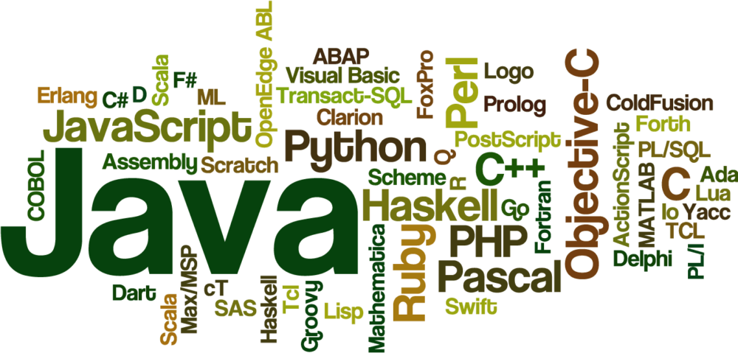


Slide 3



STACK AND QUEUE
IN
JAVA

Slide 4
STACK
Stack is an ordered list in which, insertion and deletion can be performed only at one end that is called top
Stack is a recursive data structure having pointer to its top element
A Stack is a Last In First Out (LIFO) data structure
It supports two basic operations called push and pop
The push operation adds an element at the top of the stack, and the pop operation removes an element from the top of the stack

Slide 5
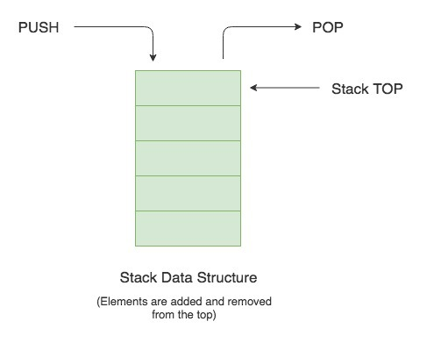
STACK STRUCTURE

Slide 6
STACK STRUCTURE
Java provides a Stack class which models the Stack data structure.
The Stack class is part of Java’s collections framework. Following is the class hierarchy of Stack in Java
STACK CLASS HIERARCHY:
The Stack class extends Vector which implements the List interface.
A Vector is a re-sizable collection.
It grows its size to accommodate new elements and shrinks the size when the elements are removed.
Since the Stack class extends Vector, it also grows and shrinks its size as needed when new elements are added or removed.

Slide 7
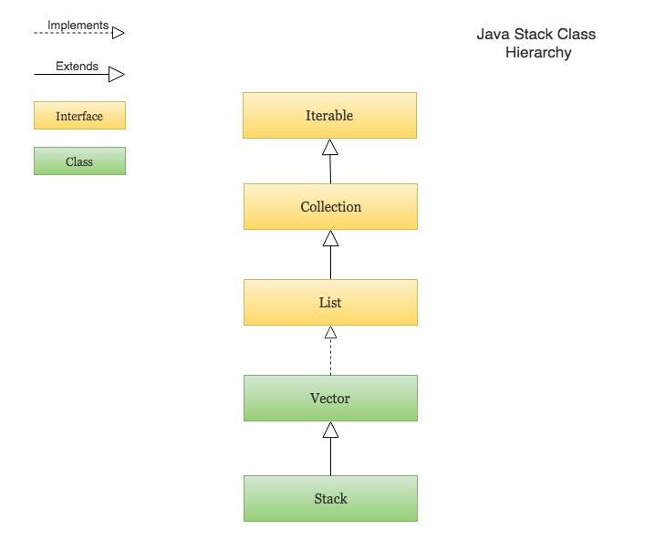
STACK CLASS HIERARCHY

Slide 8
CREATING A STACK
In order to create a stack, we must import the java.util.Stack package first. Once we import the package, here is how we can create a stack in Java
Stack<Type> stacks = new Stack<>();
Here, Type indicates the stack's type. For example,
// Create Integer type stack Stack<Integer> stacks = new Stack<>(); // Create String type stack Stack<String> stacks = new Stack<>();

Slide 9
OPERATIONS OF STACK
Stack operations may involve initializing the stack, using it and then de-initializing it. Apart from these basic stuffs, a stack is used for the following two primary operations
push() − Pushing (storing) an element on the stack
pop() − Removing (accessing) an element from the stack
When data is PUSHed onto stack.
To use a stack efficiently, we need to check the status of stack as well. For the same purpose, the following functionality is added to stacks

Slide 10
OPERATIONS OF STACK
peek() − get the top data element of the stack, without removing it
isFull() − check if stack is full
isEmpty() − check if stack is empty
At all times, we maintain a pointer to the last PUSHed data on the stack. As this pointer always represents the top of the stack, hence named top. The top pointer provides top value of the stack without actually removing it.

Slide 11
push() METHOD
To add an element to the top of the stack, we use the push() method. For example,
import java.util.Stack; class Main { public static void main(String[] args) { Stack<String> animals= new Stack<>(); animals.push("Dog"); animals.push("Horse"); animals.push("Cat"); System.out.println("Stack: " + animals); } }
Notes:
OUTPUT:
Stack: [Dog, Horse, Cat]

Slide 12
pop() METHOD
import java.util.Stack; class Main { public static void main(String[] args) { Stack<String> animals= new Stack<>(); animals.push("Dog"); animals.push("Horse"); animals.push("Cat"); System.out.println("Initial Stack: " + animals); String element = animals.pop(); System.out.println("Removed Element: " + element); } }
Notes:
OUTPUT:
Initial Stack: [Dog, Horse, Cat]
Removed Element: Cat

Slide 13
peek() METHOD
import java.util.Stack; class Main { public static void main(String[] args) { Stack<String> animals= new Stack<>(); animals.push("Dog"); animals.push("Horse"); animals.push("Cat"); System.out.println("Stack: " + animals); String element = animals.peek(); System.out.println("Element at top: " + element); } }
Notes:
OUTPUT:
Stack: [Dog, Horse, Cat]
Element at top: Cat

Slide 14
search() METHOD
import java.util.Stack; class Main { public static void main(String[] args) { Stack<String> animals= new Stack<>(); animals.push("Dog"); animals.push("Horse"); animals.push("Cat"); System.out.println("Stack: " + animals); int position = animals.search("Horse"); System.out.println("Position of Horse: " + position); } }
Notes:
OUTPUT:
Stack: [Dog, Horse, Cat]
Position of Horse: 2

Slide 15
empty() METHOD
import java.util.Stack; class Main { public static void main(String[] args) { Stack<String> animals= new Stack<>(); animals.push("Dog"); animals.push("Horse"); animals.push("Cat"); System.out.println("Stack: " + animals); boolean result = animals.empty(); System.out.println("Is the stack empty? " + result); } }
Notes:
OUTPUT:
Stack: [Dog, Horse, Cat]
Is the stack empty? false

Slide 16
TIME COMPLEXITY OF STACK OPERATION
The time complexities for various operations that can be performed on the Stack data structure
Push Operation : O(1)
Pop Operation : O(1)
Top Operation : O(1)
Search Operation : O(n)
The time complexities for push() and pop() functions are O(1) because we always have to insert or remove the data from the top of the stack, which is a one step process

Slide 17
STACK USING LINEAR LIST DATA(ARRAY)
Implement a stack using single linked list concept all the single linked list operations perform based on Stack operations LIFO(last in first out)
Storing the information in the form of nodes and we need to follow the stack rules and need to implement using single linked list nodes so what are the rules we need to follow in the implementation of a stack a simple rule that is last in first out
All the operations we should perform so with the help of a top variable only with the help of top variables are how to insert the elements

Slide 18
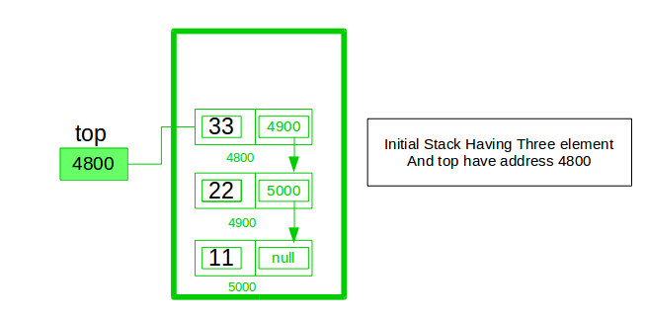
OPERATION
Notes:
A stack can be easily implemented through the linked list. In stack Implementation, a stack contains a top pointer. which is “head” of the stack where pushing and popping items happens at the head of the list. first node have null in link field and second node link have first node address in link field and so on and last node address in “top” pointer.

Slide 19
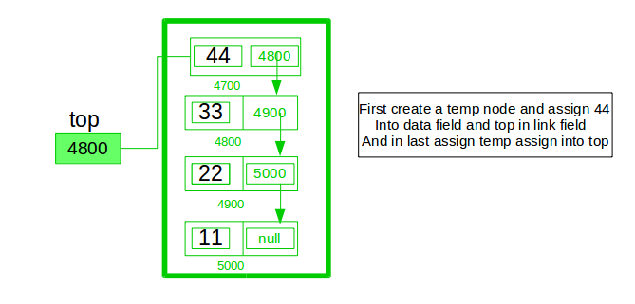
OPERATION

Slide 20
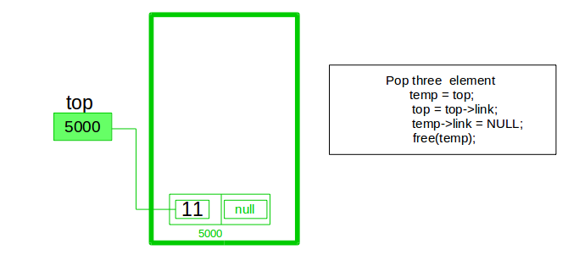
OPERATION

Slide 21
Advantages
The main advantage of using linked list over an arrays is that it is possible to implements a stack that can shrink or grow as much as needed
In using array will put a restriction to the maximum capacity of the array which can lead to stack overflow
Here each new node will be dynamically allocate so overflow is not possible

Slide 22
PROGRAM
import static java.lang.System.exit; class StackUsingLinkedlist { private class Node { int data; Node link;} Node top; StackUsingLinkedlist() { this.top = null; } public void push(int x) | { Node temp = new Node(); if (temp == null) { System.out.print("\nHeap Overflow"); return; } public int peek() { if (!isEmpty()) { return top.data; } else { System.out.println("Stack is empty"); return -1; }

Slide 23
PROGRAM
public void pop() { if (top == null) { System.out.print("\nStack Underflow"); return; } top = (top).link; } public void display() { if (top == null) { System.out.printf("\nStack Underflow"); exit(1); | } else { Node temp = top; while (temp != null) { System.out.printf("%d->", temp.data); temp = temp.link; } } } }

Slide 24
PROGRAM
public class Main{ public static void main(String[] args) { StackUsingLinkedlist obj = new StackUsingLinkedlist(); obj.push(11); obj.push(22); obj.push(33); obj.push(44); | obj.display(); System.out.printf("\nTop element is %d\n", obj.peek()); obj.pop(); obj.pop(); obj.display(); System.out.printf("\nTop element is %d\n", obj.peek()); } }
Notes:
Output:
44->33->22->11->
Top element is 44
22->11->
Top element is 22

Slide 25

THANK YOU

